Slide 1
Spring Design
ME 313: Mechanical Design
Week 6

Slide 2
Springs
Any elastic which exerts resisting force when the shape is changed
Here, assume that all springs are linear, e.g.

Slide 3
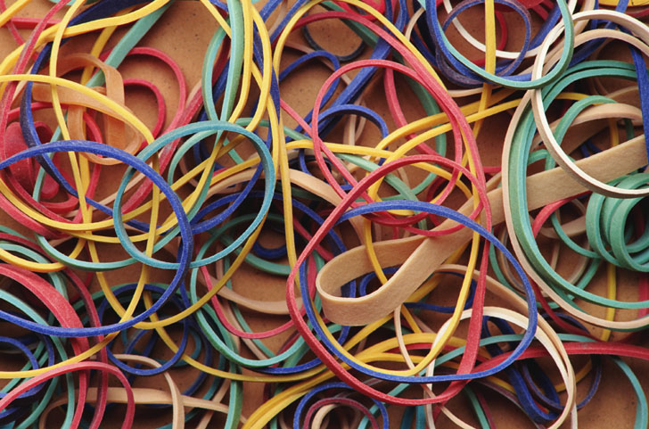
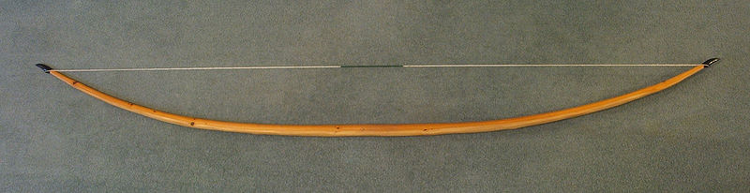
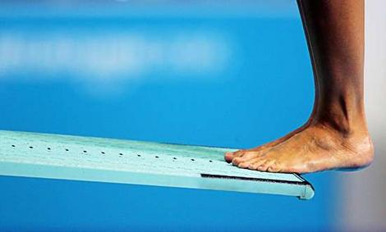
Springs in Daily Life

Slide 4
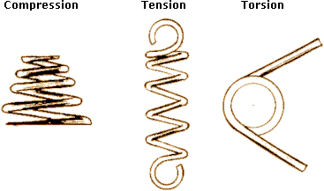
Types of Springs

Slide 5
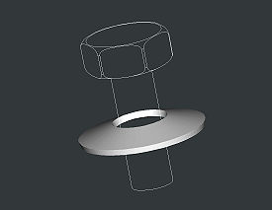
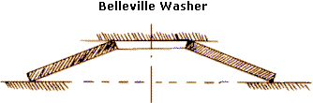
Other Types of Springs
Belleville washer
Used when space is limited

Slide 6

Other Types of Springs (cont)
Leaf spring
Deforms by bending
Laminated leaf spring
Where have you seen this used? Why?

Slide 7
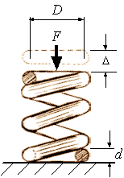
Spring Dimensions
D = nominal coil diameter
d = wire diameter
x

Slide 8
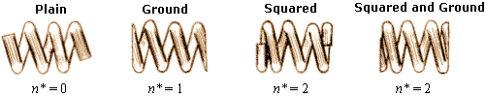
Active Number of Coils, n_{a}
Number of coils taking the load
Depends on end characteristics of spring

Slide 9
Spring Stiffness
x

Slide 10
Spring Index
Ratio of nominal coil diameter to wire diameter

Slide 11
Length of Active Coil
Length of wire in active coils

Slide 12
Spring Failure
There are two failure modes to consider when designing springs
Wire breakage
Spring buckling

Slide 13
Wire Breakage
Since spring is under torsion, spring fails due to … stress
Maximum shear stress in spring is
where W is Wahl’s correction factor

Slide 14
Spring Buckling
Occurs in compression springs when spring is too long or too thin
Basic rule of thumb: length should be no longer than 4 times nominal coil diameter

Slide 15
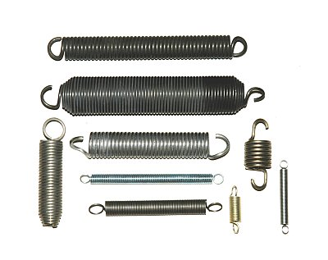
Extension Springs
Normally manufactured so coils are pressed together
Initial force F_{i} must be applied to separate the spring before it starts behaving linearly

Slide 16
Extension Spring Stiffness
Once the coils separate, extension springs behave much like compression spring
F
F_{i}
x
Notes:
Note that it’s using total number of coils

Slide 17
Maximum Shear Stress in Extension Spring
Maximum shear stress is the sum of stresses from initial force and additional load

Slide 18
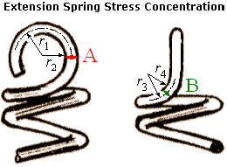
End Stress Concentration
Hooks create stress concentration at spring ends

Slide 19
Spring Natural Frequency
Spring natural frequency should be much higher (15-20 times) than the system frequency to prevent resonance

Slide 20
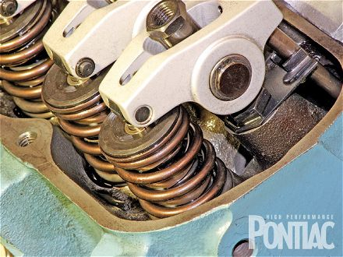
Example: Valve Spring
If the engine maximum operating speed is 8000 rpm, and we must design the spring so that d = 0.5 cm, D = 3 cm, G = 200 GPa, and material density = 7800 kg/m³, what is the required length of wire needed to make spring?

Slide 21
Spring Design: Summary
Consider these things
Spring geometry (D, d, n_{t}, n_{a})
Spring material (G, yield)
Operating conditions (natural frequency)

